Slide 1
Focus on Activation Functions
Anna Naden
Machine learning hobbyist
April 13, 2021

Slide 2
Comments and Questions Welcome
Have you used this activation function?
How well did it work?

Slide 3
Gap: Theory vs. Practice
I need your input
Many activation functions proposed based on mathematical properties
In practice, ReLU for hidden layers and sigmoid for output classification layer
Many papers on the expressivity of activation functions but they are very abstract and don’t mention specific applications
Few or no comprehensive papers guiding selection of functions for a particular application

Slide 4
Considerations in Choice of Activation Functions
Output function: Softmax for classification, logistic for binary classification or multilabel classification
Vanishing gradient problem: ReLU
Computational cost
Expressivity
Use of dropout for regularization (to avoid over-fitting)
Sampling distribution: e.g., logistic output for mixed Gaussian
Zero-centered
Choice of optimizer

Slide 5
Expressivity of Activation Functions
Linear activation just gives linear regression – equivalent to single layer no matter how many layers are present
Example: approximating a sine function with ReLU
Neural Networks from Scratch in Python, Harrison Kinsley and Daniel Kukiela
Approximation by Superpositions of Sigmoidal Functions
Approximation Capabilities of Multilayer Feedforward Networks
Multilayer Feedforward Networks with a Non-polynomial Activation Can Approximate any Function
Approximation Theory of the Multilayer Feedforward Perceptron Model

Slide 6
Expressivity Papers
Universal Approximation Theorem
Approximation by Superpositions of Sigmoidal Functions
Approximation Capabilities of Multilayer Feedforward Networks
Multilayer Feedforward Networks with a Non-polynomial Activation Can Approximate any Function
Approximation Theory of the Multilayer Feedforward Perceptron Model

Slide 7
Activation Functions in Artificial Neural Networks: A Systematic Overview
Johannes Lederer
Department of Mathematics
Ruhr-University Bochum, Germany
Introduction
Common Activation Functions
Practical Implications

Slide 8
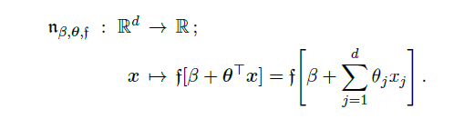
Definition

Slide 9
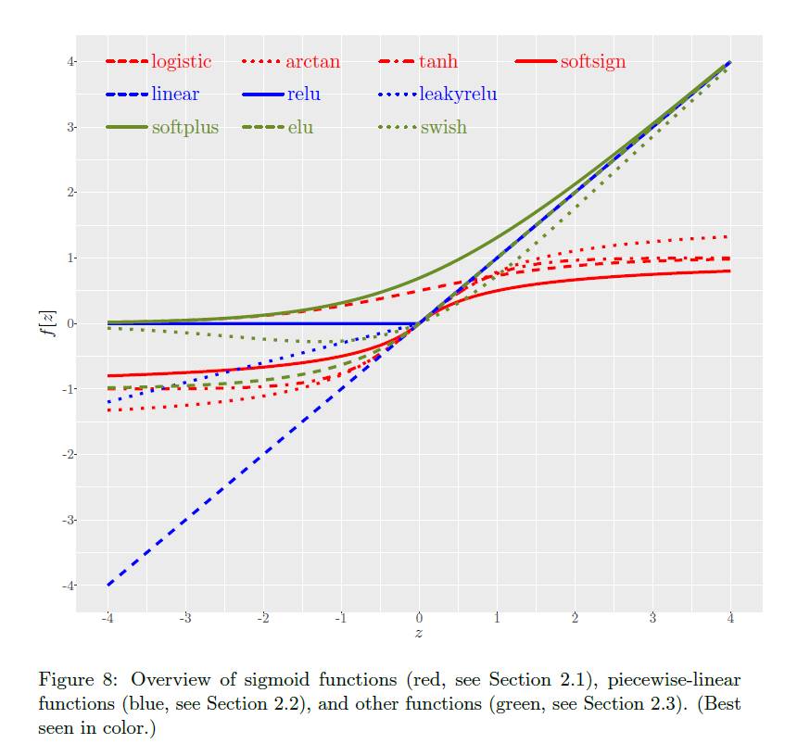

Slide 10
Sigmoid Family: bounded, monotonic, single inflection point
Logistic (sigmoid): binary classification (round)
Logistic (sigmoid): multilabel classification (not normalized, classes are not mutually exclusive)
Arctan
Tanh (hyperbolic tangent)
Softsign
Approximation by Superpositions of Sigmoidal Functions

Slide 11
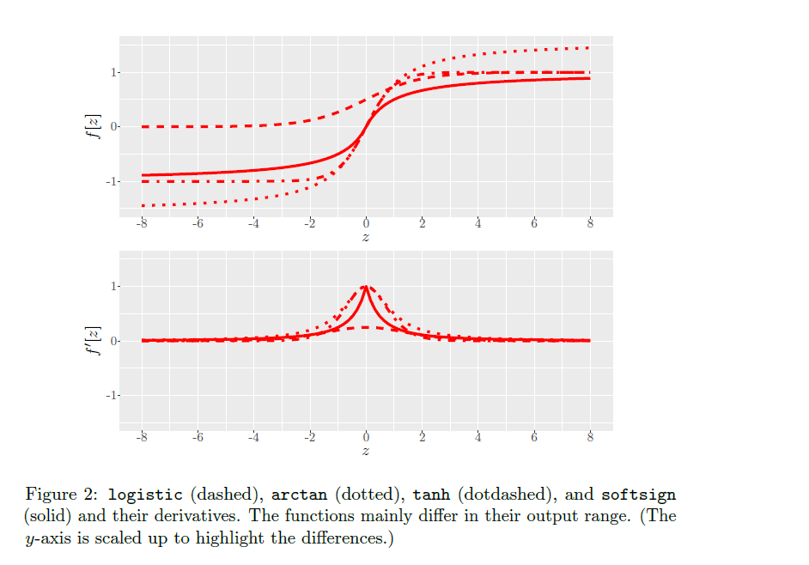

Slide 12
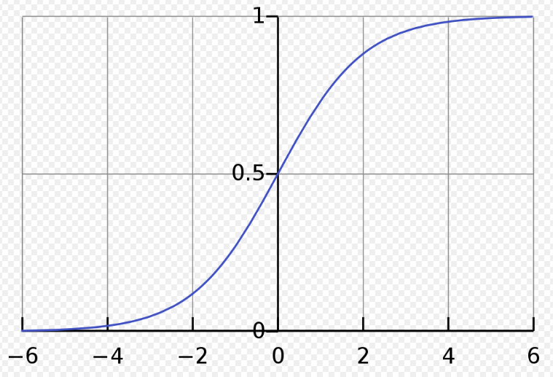

Logistic (sigmoid) : $\frac{1}{1+exp⁡(−z)}$
Range 0-1
Used for binary and multilabel classification
Computationally more expensive
Round output to get binary label
Gradient small away from zero (vanishing gradient problem)
Can be used for multilabel classification

Slide 13

Derivation of Logistic Activation Function
C. Bishop, Neural Networks for Pattern Recognition, equations 3.10-3.19
Two classes, each with Gaussian distribution
Neural network weights:
$$a=w^{T}x+w_{0}$$
$$w=Σ^{−1}\left(μ_{1}−μ_{2}\right)$$
$$w_{0}=−\frac{1}{2}μ_{1}^{T}Σ^{−1}μ_{1}+\frac{1}{2}μ_{2 }Σ^{−1}μ_{2}+ln⁡(\frac{P(C_{1})}{P(C_{2})})$$

Slide 14
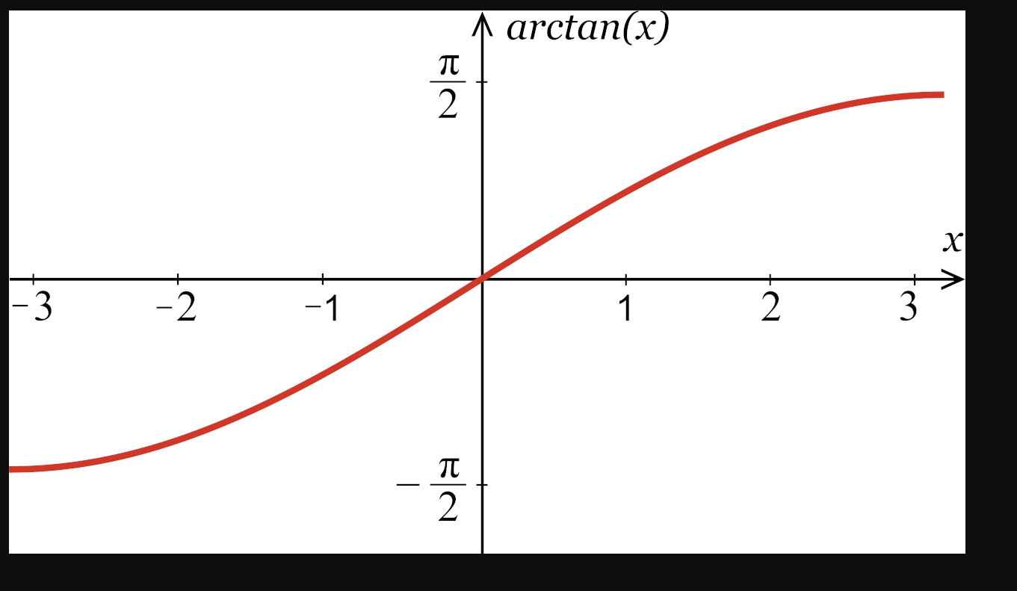


arctan: $z=\frac{sin⁡(x)}{tan⁡(x)}$
Derivative easy to compute $\frac{1}{1+z^{2}}$

Slide 15
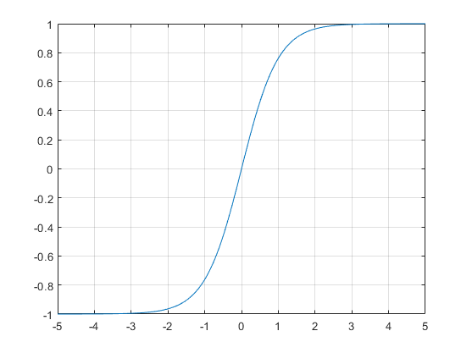


Hyperbolic Tangent: $\tanh\left(x\right)=\frac{e^{x}− e^{−x}}{e^{x+ }e^{−x}}$
Derivative easy to compute: $y^{′}=1−y^{2}$
Said to work better than sigmoid because zero-centered (except for output layer binary classification)
(Andrew Ng)
Vanishing gradient problem

Slide 16
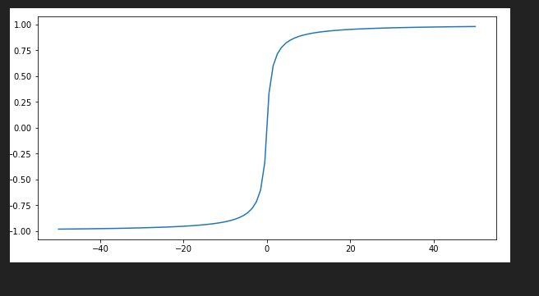

softsign: $\frac{z}{1+|z|}$
Range [0,1] – for classifier output layer
Computationally very cheap
Derivative not continuous at zero
Advocated by author
I simply substituted it for logistic on the output layer of NMIST classifier: the performance degraded

Slide 17
Piecewise Linear Activation Functions
Linear
ReLU
Leaky ReLU

Slide 18
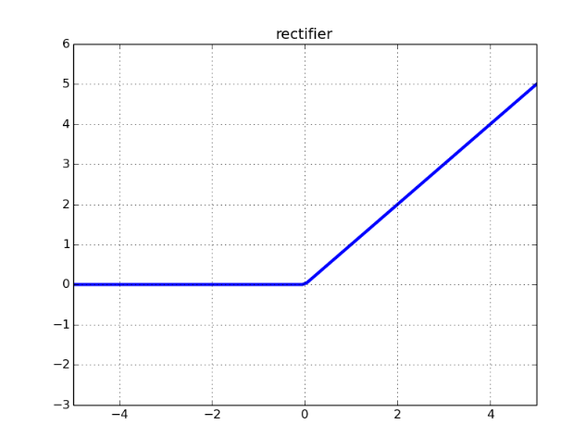

ReLU
$y=\max\left(0,x\right)$
Doesn’t saturate – helps mitigate vanishing gradient problem
Dies when input less than zero – dead neuron problem
Standard for many years
Not for output layer when doing classification

Slide 19
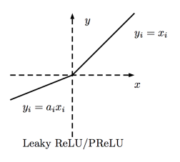

Leaky ReLU
$y=\max\left(ax,x\right)$
A=0.01 for example
Doesn’t saturate – helps mitigate vanishing gradient problem
Doesn’t die for negative inputs – avoid dead neuron problem

Slide 20
Other Functions
softplus
elu and selu
swish
softmax: output layer for classification – normalized class probability

Slide 21

Softmax: $\frac{e^{z_{i}^{}}}{Σe^{z_{i}}}$
Converts a vector of arbitrary numbers to a vector of probabilities
Used for output layer to select one of a group of mutually exclusive classes

Slide 22
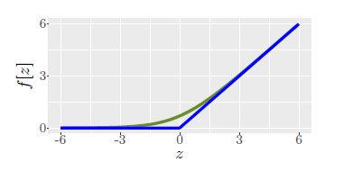

softplus: $log⁡[1+e^{z}$]
Range [0,∞)
Like ReLU
More expensive
Derivative does not vanish

Slide 23
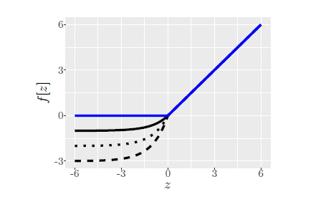

elu and selu
$f\left(z\right)=z for z≥0$
$f\left(z\right)=a\left(e^{z}−1\right)$ for z<0
Generalization of ReLU (a=0)
Derivative strictly positive
Expensive
Scalable: $a_{0}z$ for $z≥0$
$b_{0}\left(e^{z}−1\right)$ for $z<0$

Slide 24
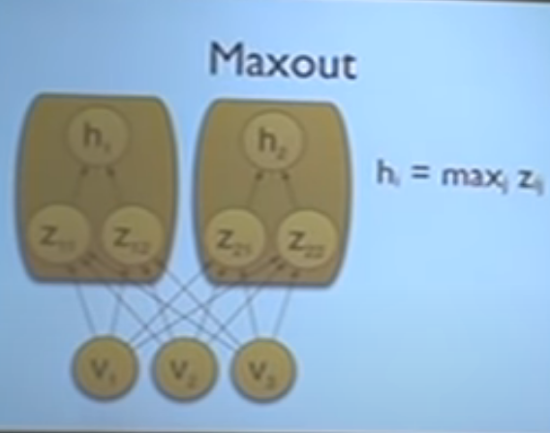
Maxout: an Adaptive Activation Function for Use With Dropout
Maximum of inputs
As weights are adjusted, the effective activation function is adapted
Even with ReLU, the gradient never vanishes
References:
Goodfellow paper Maxout Networks
Goodfellow thesis defense: YouTube (2014)

Slide 25
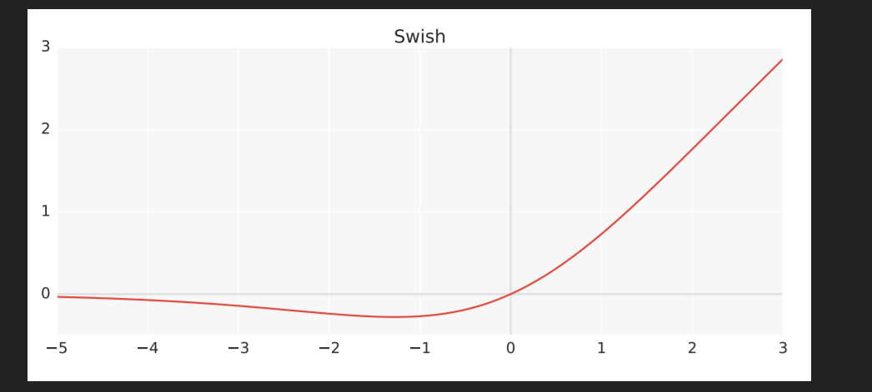

swish: $\frac{z}{1+e^{−az}}$
Deep networks > 40 layers
Google

Slide 26
Conclusions
Softsign computationally efficient, but it may not work to just substitute it for softmax
ReLU tried and true

